Slide 1
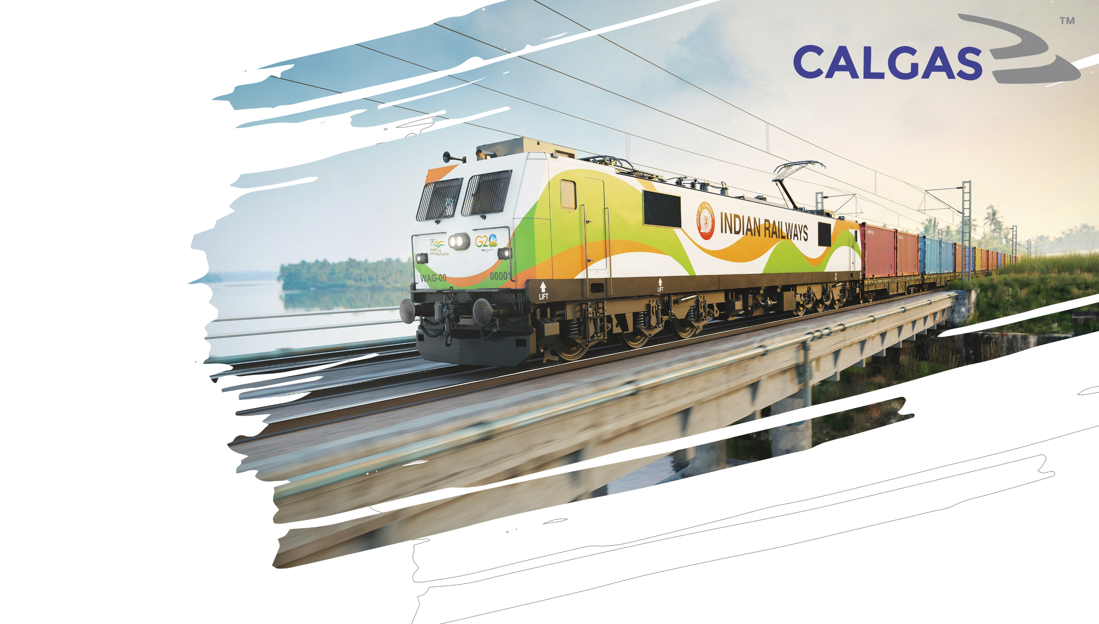

A SUPPLIER TO
FUTURE OF MOBILITY
COMPANY PROFILE

Slide 2
About us
CALGAS was Founded in 2001 under a Vision of Make in India for Railway Electricals and Electronics Spares Parts.
Mr. Bimal Kr. Dugar CEO has an Experience of 30+ Years in the Industries & Mr. Santosh Kr Bothra (Director) has an Experience of 20+ Years in the Industries with their expertise and focus we have taken approvals of more than 10 Import Substitutes Collaborations with various Manufacturers.
Few of our CLW Approved items & Annual Requirements are presented in this presentation.
Our Aim is to add few more Critical items for Railway Industries every year to serve Indian Railways & OEMs better and more focused.

Slide 3
Pioneering Transformative Growth in Indian Railways
Introduction
In the dynamic landscape of India's railway sector, CALGAS emerges as a visionary powerhouse, contributing to the nation's relentless pursuit of modernization and self-sufficiency. As a conglomerate with a steadfast commitment to innovation, CALGAS has cemented its position as a key player in the rail industry, catalyzing transformative change through strategic partnerships, impeccable quality, and a profound dedication to India's railway ecosystem.
Onboarding New OEMs and Manufacturers
CALGAS has established itself as a vital conduit for Original Equipment Manufacturers (OEMs) and manufacturers aiming to navigate the labyrinth of the Indian railways. By facilitating the entry of these companies into the Indian railway ecosystem, CALGAS is not only fostering long-term business relationships but also fortifying the railways' resilience with an infusion of fresh talent and cutting-edge solutions. This collaborative endeavour signifies a significant step towards a more efficient and technologically advanced rail network.
Supporting Product Introduction and Techno-Commercial Assistance
The CALGAS role extends beyond mere introduction; it encompasses a comprehensive commitment to its partners' success. By offering unwavering support in introducing new products to the railways, we ensures that the transformative potential of these innovations reaches their maximum audience. Furthermore, CALGAS provides essential techno-commercial support, guiding these companies through the intricacies of the Indian railways market, ensuring that their offerings align seamlessly with the railways' unique needs.
Championing 'Make in India' and 'Aatma Nirbhar Bharat' Initiatives
CALGAS contributions to 'Make in India' and 'Aatma Nirbhar Bharat' initiatives are a testament to its dedication to fostering self-reliance and self-sufficiency in the Indian railway sector. By facilitating the entry of new players into the railway ecosystem, CALGAS plays a pivotal role in strengthening the domestic manufacturing sector. This alignment with the government's vision underscores the company's role in shaping the future of India's railways.
In the realm of India's railway industry, CALGAS is not just a corporate entity; it is a driving force behind progress and transformation. With its focus on enabling new entrants, introducing innovative products, and aligning with the 'Make in India' and 'Aatma Nirbhar Bharat' initiatives, the group embodies the spirit of collaborative growth, driving India's railways towards a brighter, more self-sufficient future

Slide 4
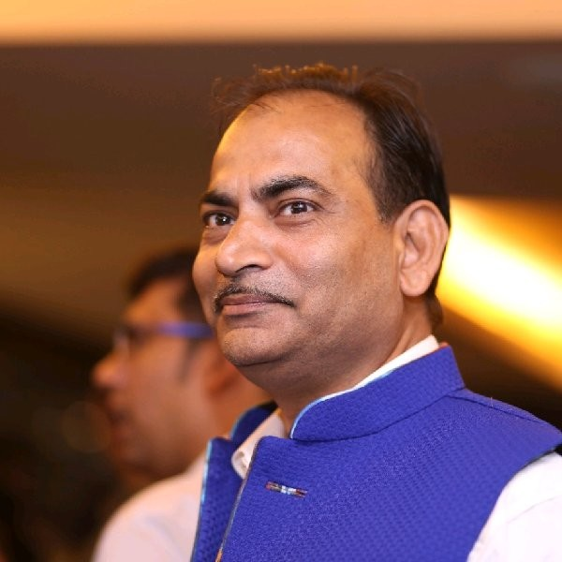
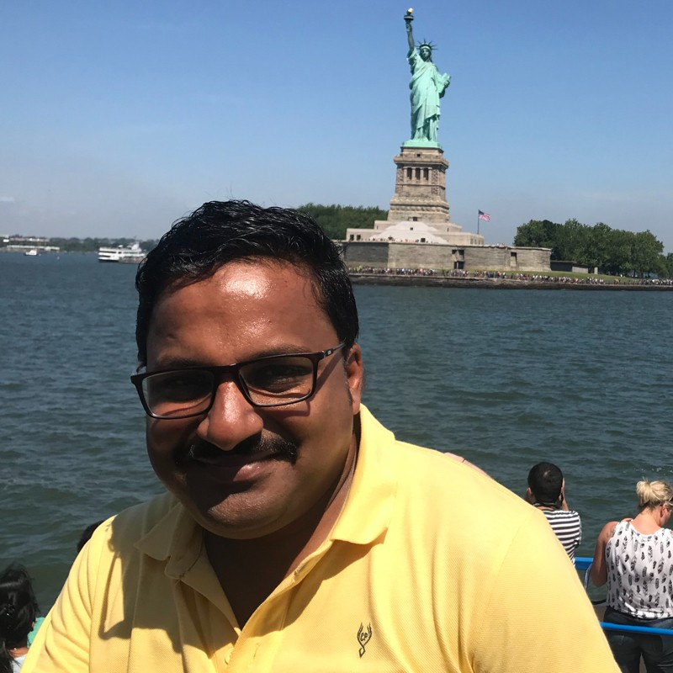
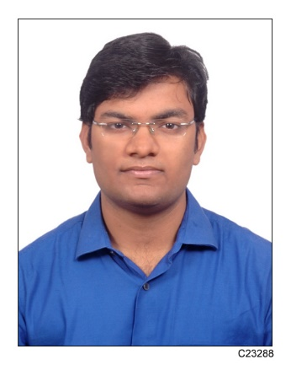
OUR CORE TEAM
Bimal Kumar Dugar
CEO
Santosh Kumar Bothra
Director
Pankaj Dugar
MARKETING HEAD

Slide 5
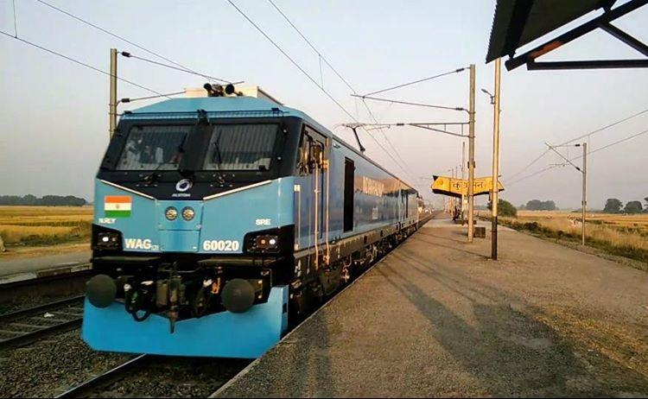


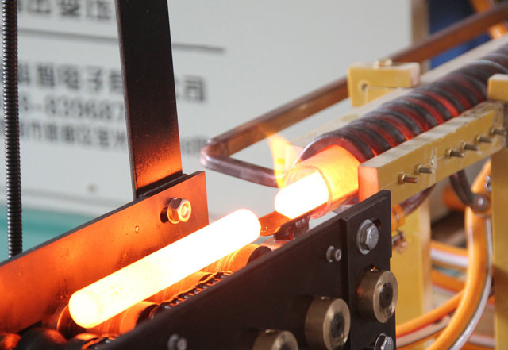
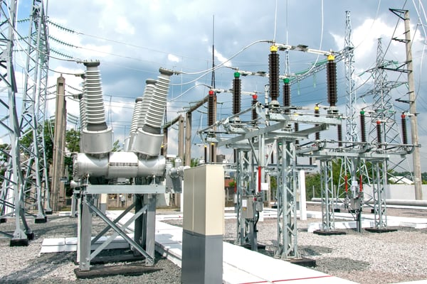

INDUSTRIES WE SERVE
RAILWAYS
POWER ENERGY
E MOBILITY
INDUCTION INDUSTRIES
HIGH VOLTAGE
REAL STATE

Slide 6

































OUR CLIENT’S
Private & Public Sector
& Many More…!

Slide 7











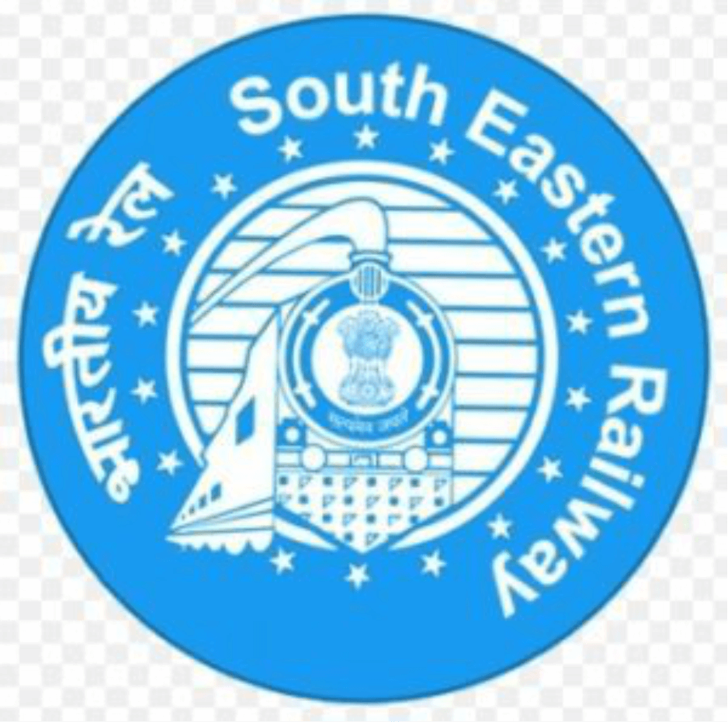









OUR CLIENT’S
Production Units
Chittranjan Locomotive Works
Diesel Locomotive Works
Diesel Loco Modernization Works
Rail Coach Factory
Railways & Metro Zone
Central Railway
East Central Railway
  East Coast Railway
  Eastern Railway
North Central Railways
North Eastern
Frontier Railways
North Eastern Railway
Northern Railway
North Western Railway
South Eastern Railways
Southern Railways
South Central Railway
South Cost Railway
South East Central Railway
South Western Railway
West Central Railway
Western Railway
Kolkata Metro Rail
& Many More…!

Slide 8




















OUR PRINCIPAL & PRODUCT CATEGORIES
Power Semiconductors
Capacitors
Resistors
Sensors
SS & Brass Fittings
Metallic Bellows
Quick Couplings
Surge Arrestors
SS & Copper Tubes
PARASMANI TUBES
Relay & Control Units
Transformer Spares Parts
High Voltage Cable & Accessories
KUNA
EV Charger & Accessories
UAV
& Many More…!

Slide 9

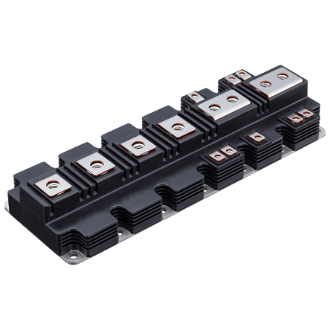

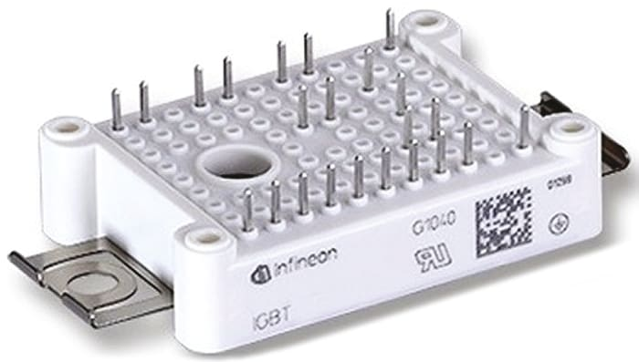
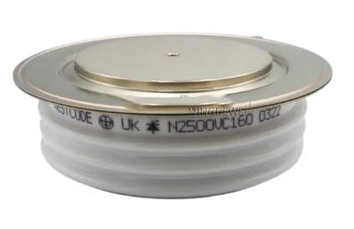
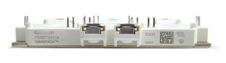
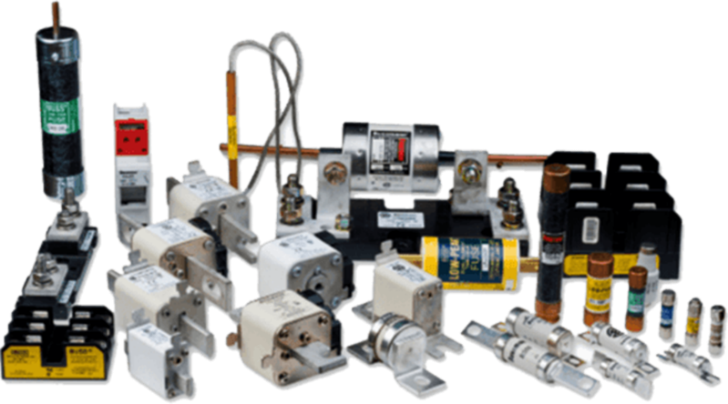

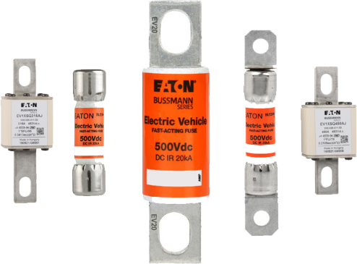
Power Semiconductors
IGBT & DIODE MODULES POWER MODULES THYRISTOR
INDUSTRIAL FUSE EV FUSE LOW & HIGH VOLTAGE FUSE

Slide 10

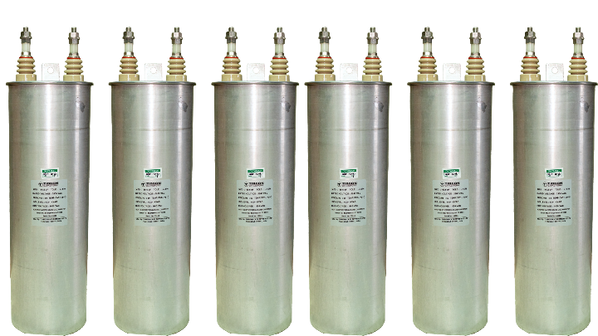

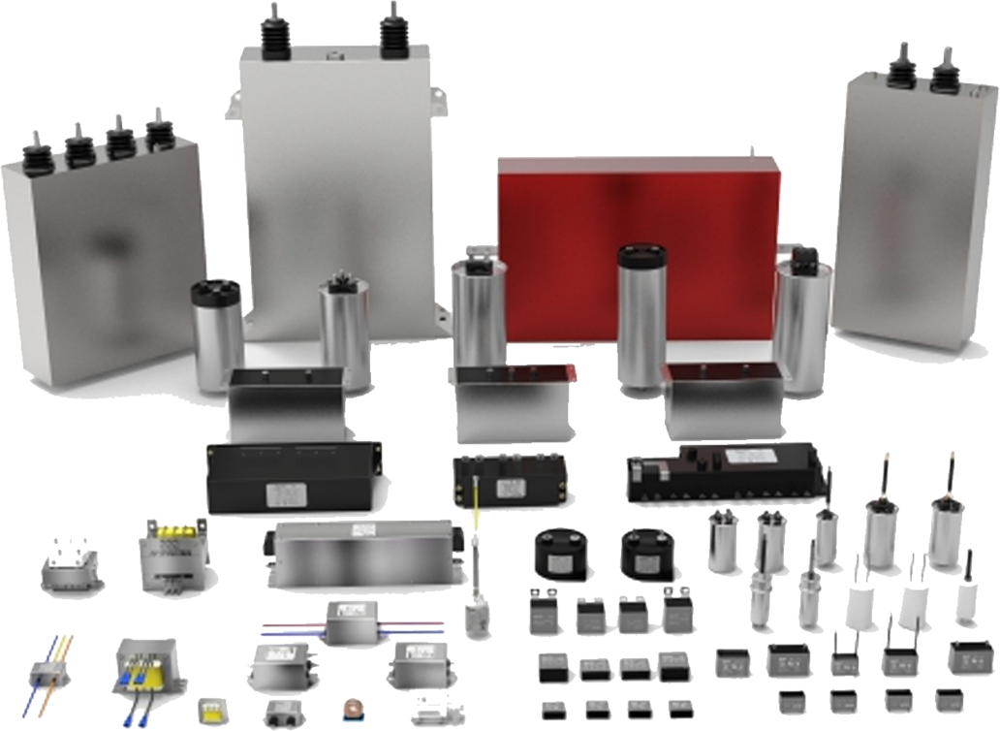
Capacitors
HARMONIC FILTER CAPACITORS
DC LINK CAPACITORS
SNUBBER CAPACITORS
EV CAPACITORS

Slide 11

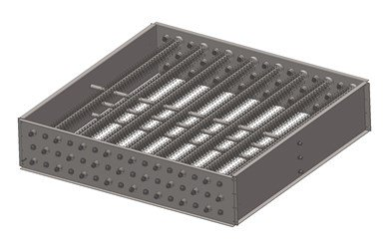
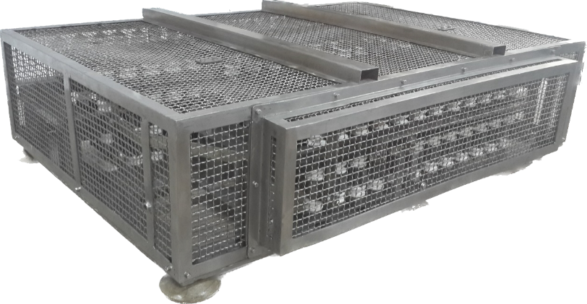
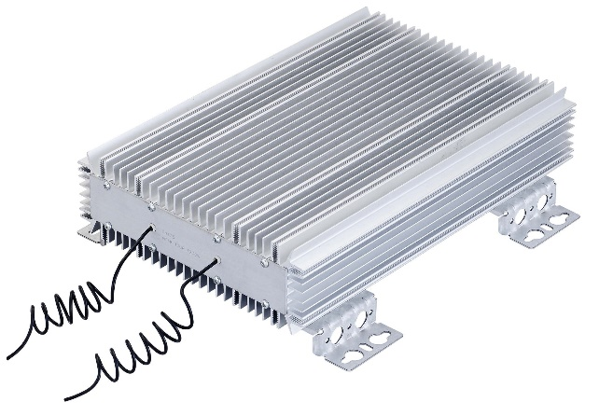
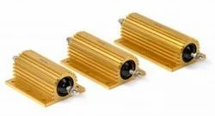
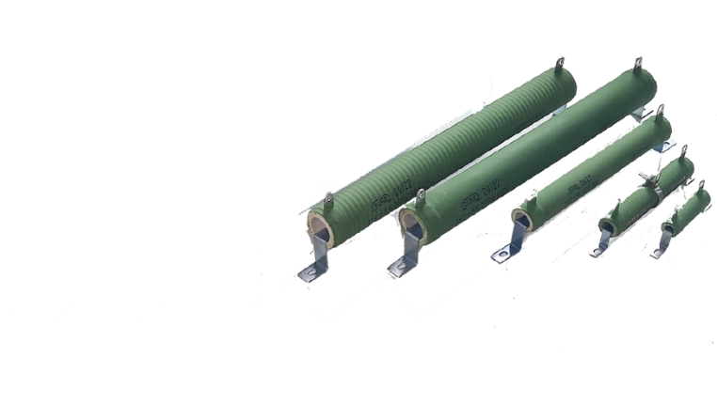
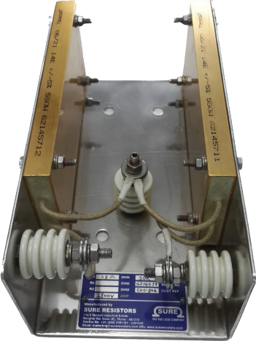
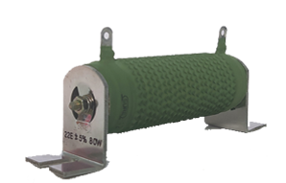
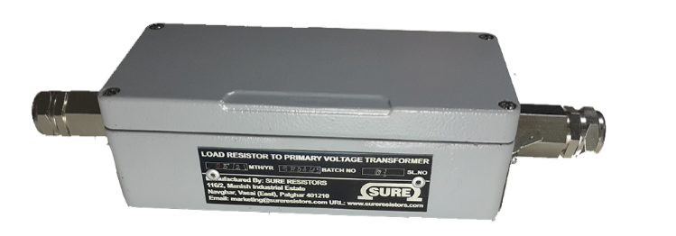
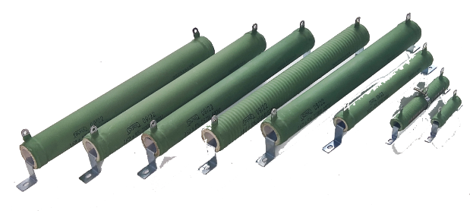
Resistors
HARMONIC FILTER RESISTOR PRE CHARGING LOAD BANK ALUMINIUM
WIRE WOULD RESISTORS DISCHARGING LOAD RESISTORS

Slide 12


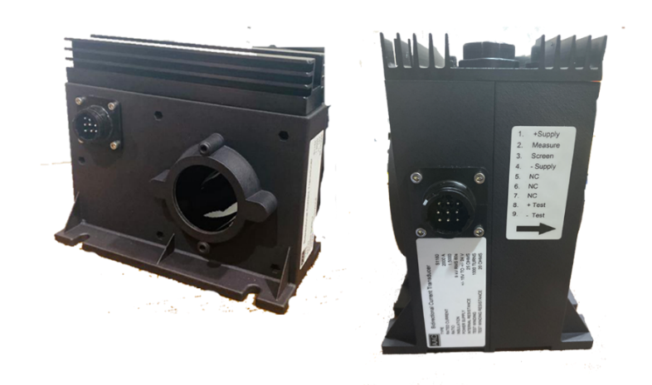

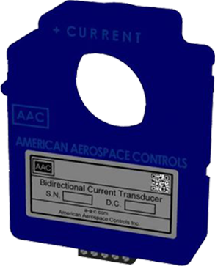

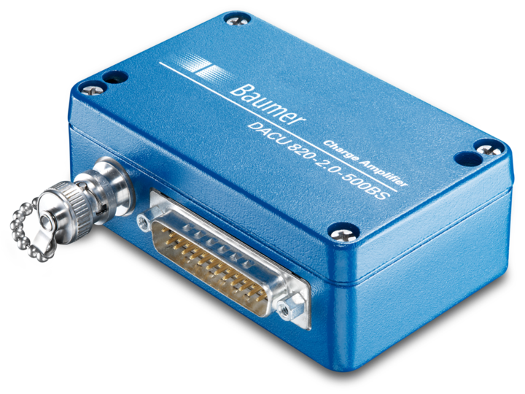
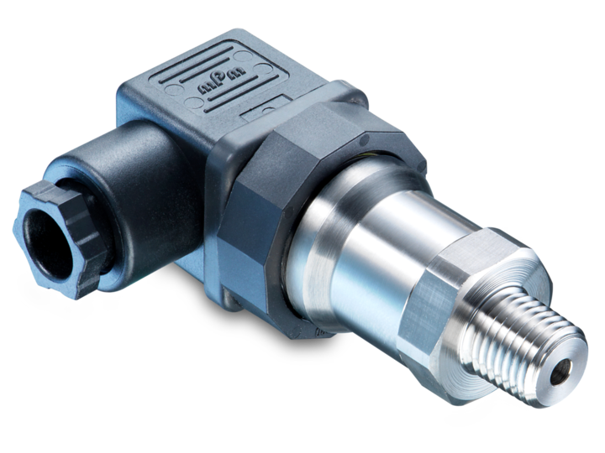
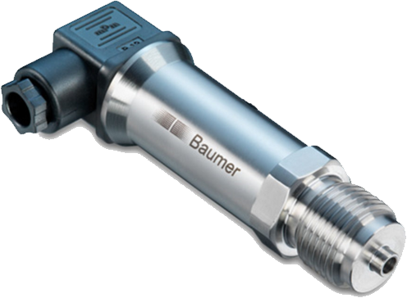
Sensors
PRIMARY CURRENT DC CURRENT HALL TYPE DC CURRENT
PRESSURE SENSOR AMPLIFIER SENSOR PRESSURE TRANSDUCER

Slide 13

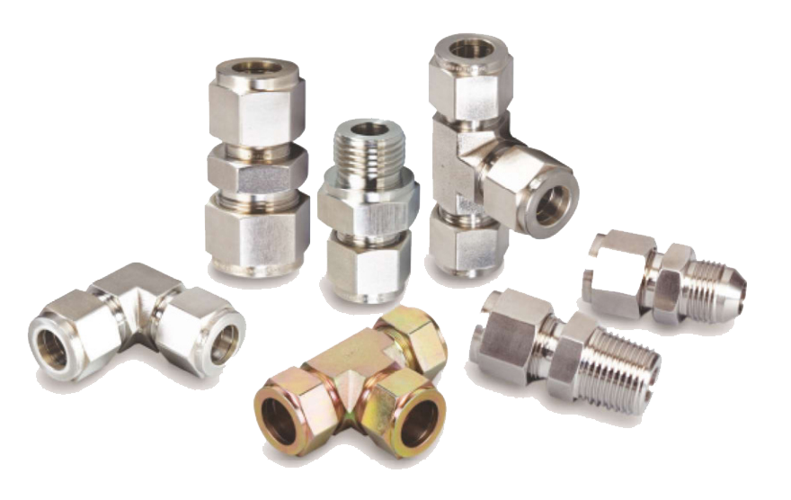
SS & Brass Fittings
SS & BRASS DOUBLE FERRULE FITTINGS

Slide 14

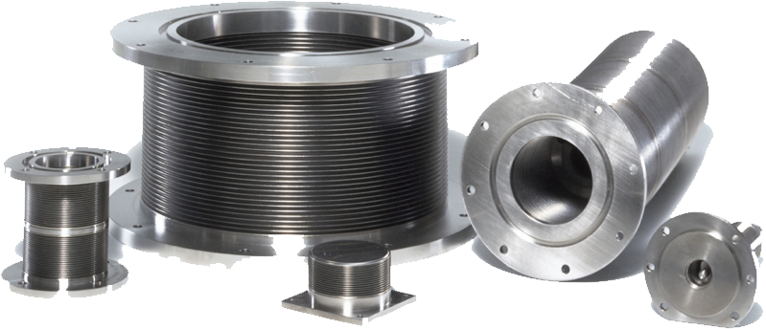
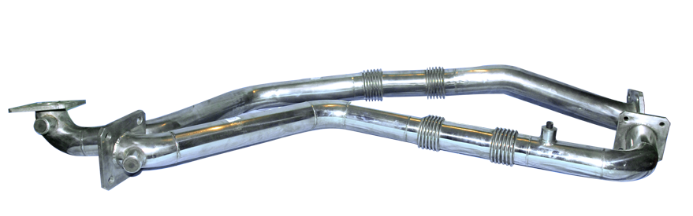
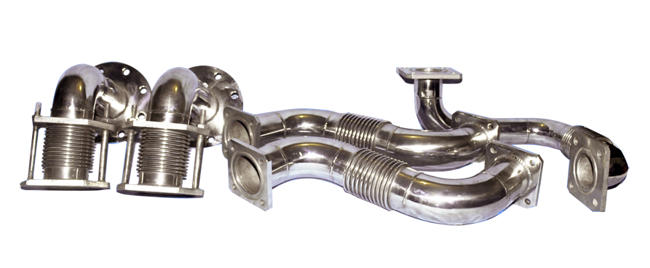
Metallic Bellows
METTALIC BELLOWS METTALIC PIPES FOR TRANSFORMER

Slide 15

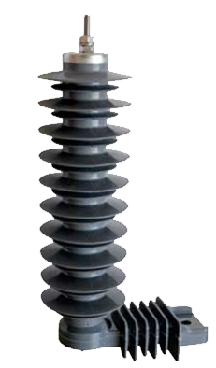
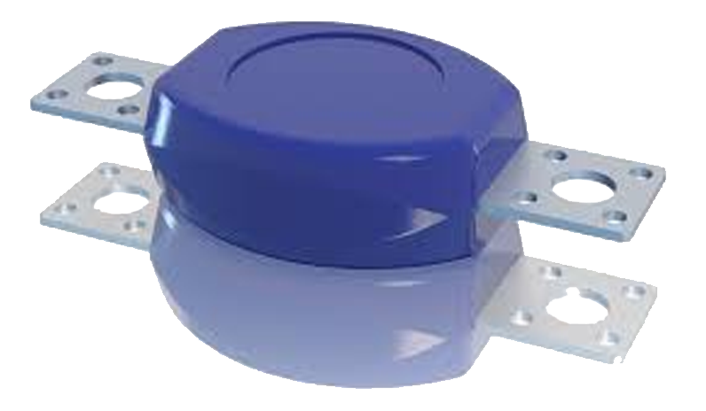
Surge Arrestors
SURGE ARRESTORS FOR TRANSFORMERS & CONVERTOR

Slide 16
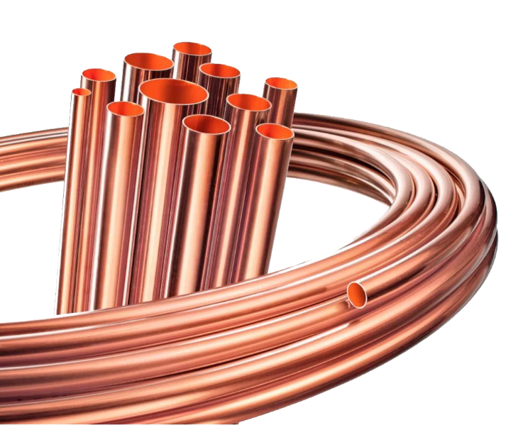
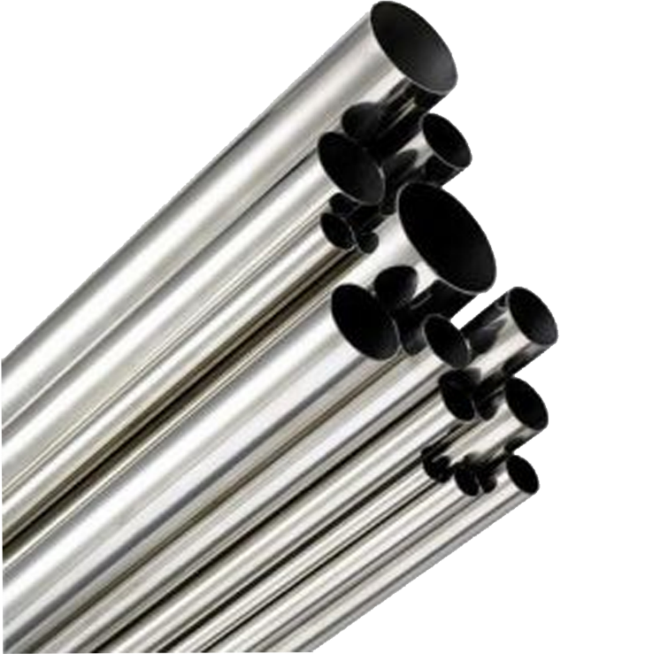
SS & Copper Tubes
PARASMANI TUBES
COPPER TUBES SS TUBES

Slide 17
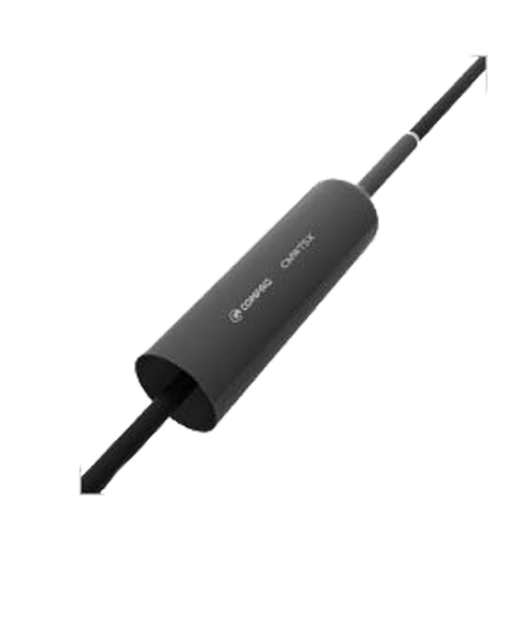
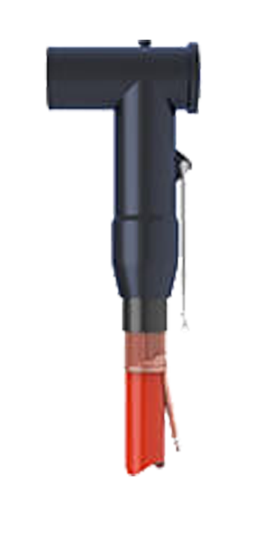
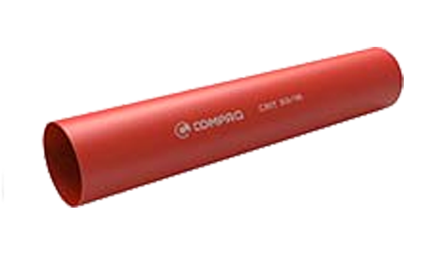
High Voltage Cable & Accessories
Screened Separable Elbow Connector High-Shrink Heat Shrinkable Tubing

Slide 18
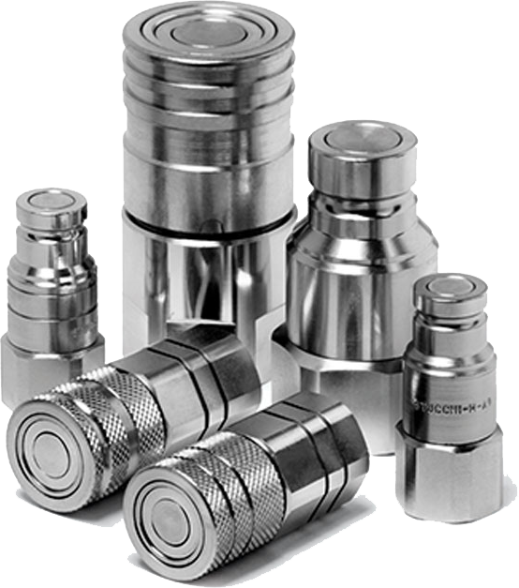
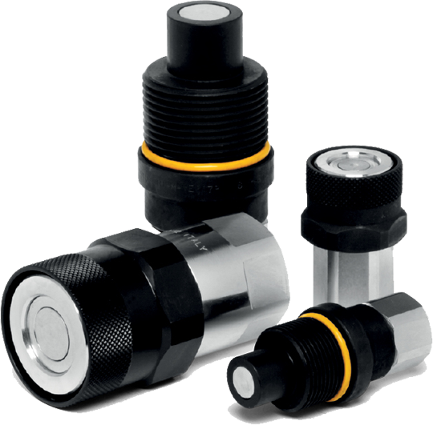
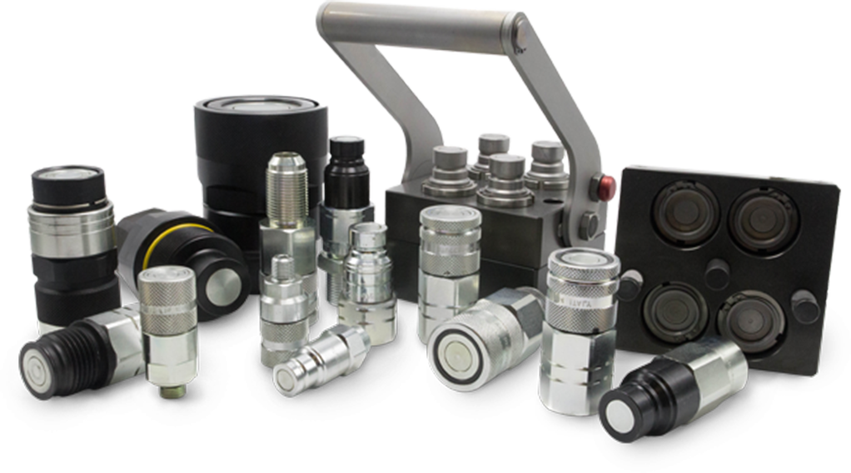
Quick Couplings

Slide 19

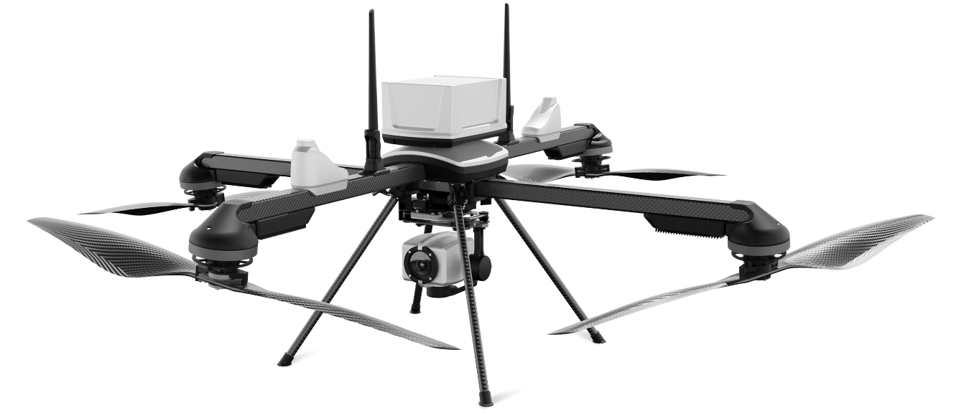
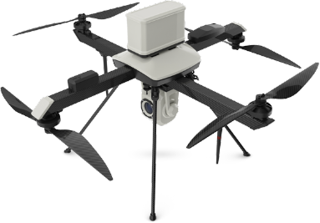
UAV
For Surveillance of Loco shed, Workshops and Track Monitoring

Slide 20

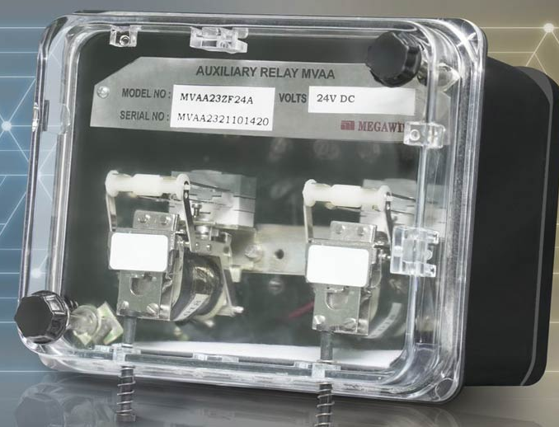
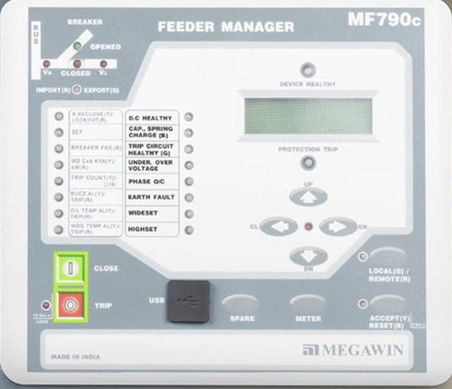
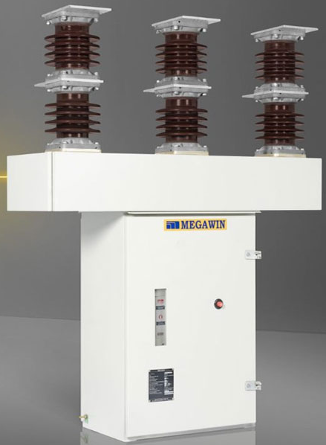
Relay & Control Units
AUXILIARY RELAY CONTROL UNIT PCVCB

Slide 21
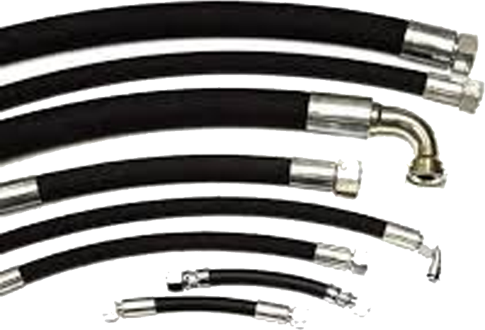







Transformer Spares Parts
KUNA
VALVES HOSE PIPES FOR TRANSFORMERS
PRESSURE RELIF VALVES BUSHING OIL LEVEL INDICATORS

Slide 22


EV Chargers

Slide 23



NOMINATION FOR AWARDS

Slide 24





CERTIFICATE NO: DIPP192382
Thank You
CALGAS MOBILITY PRIVATE LIMITED (formerly known as M/s. Calcutta Gaskets and Engineering Concern)
Registered Office : Fortuna Tower, 23A Netaji Subhas Road, 7th Floor, Kolkata West Bengal -700001
Works Address: Tentulkuli Industrial Estate (Behind Pakuria Salasar Dham)Tentukuli Purbopara, Howrah West Bengal -711409
Phone: 033-4601 7439 | Email: sales@calgas.in | Web: www.calgas.in
OUR EXTENDED ARM - OSIAN MERCANTILES
Registered Office: 56, Netaji Subhas Road, 4th Floor, Kolkata -700 001
Phone: 033-4601 7439 | Email: sales@osiangroup.com | Web: www.osiangroup.com

